Slide 1
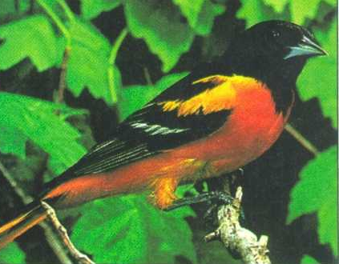
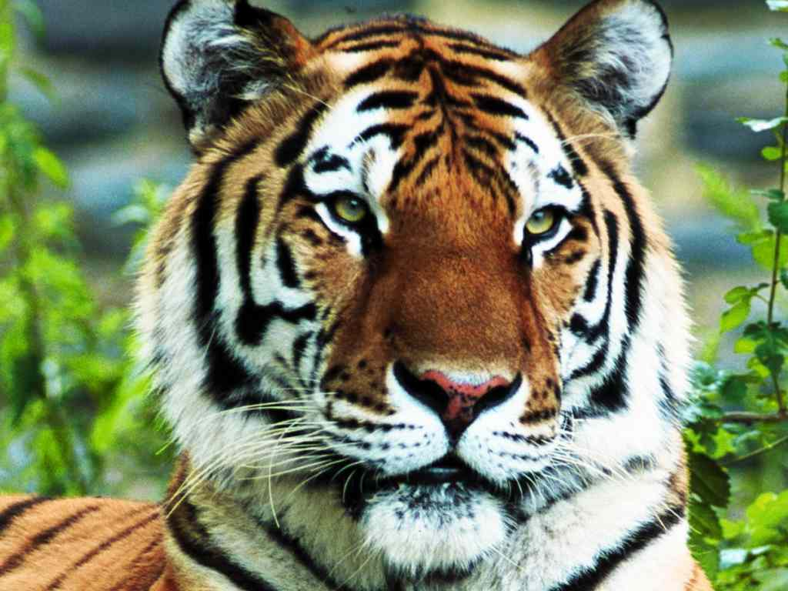
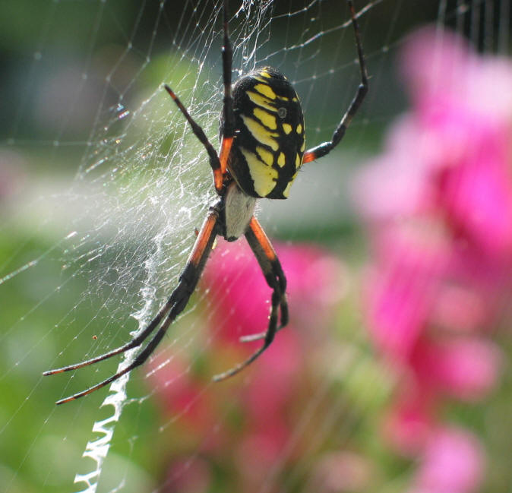

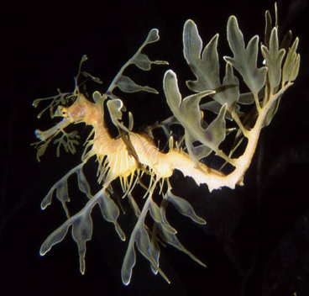

Classification of Life

Slide 2
Taxonomy:
Methods of Classification
Purpose:
To put an organism into a category that reflects its evolutionary history (phylogeny) to others
Types of Data Used:
structural/biochemical characteristics
life cycles
fossils
embryonic patterns of development
*amino acid sequencing
*DNA analysis

Slide 3
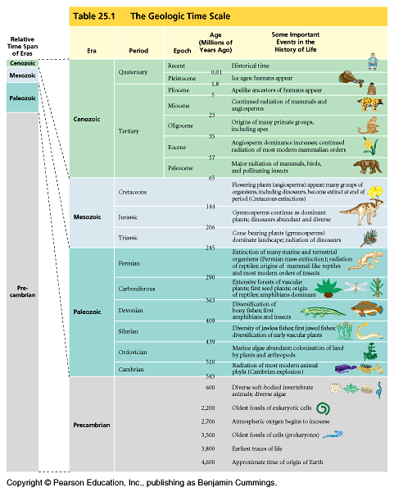
Geological
Time
Scale
~4.6 b.y.

Slide 4
BIOLOGICAL CLASSIFICATION
“King Philip Came Over From Greece Singing (Songs)”

Slide 5
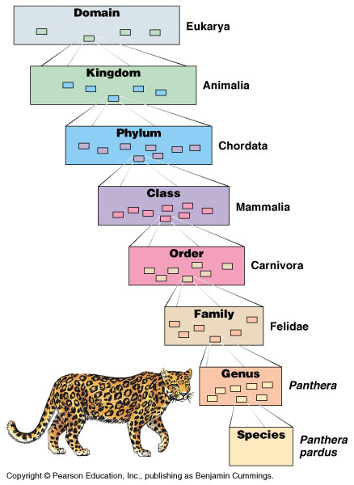
3 Domain System:
2 Prokaryotic & 1 Eukaryotic
KINGDOM
PHYLUM
CLASS
ORDER
FAMILY
GENUS
SPECIES

Slide 6
Binomial Nomenclature
In the 18th century, Carolus Linnaeus published a system of taxonomy based on resemblances
Two key features of his system remain useful today: two-part names for species and hierarchical classification
© 2011 Pearson Education, Inc.

Slide 7
The two-part scientific name of a species is called a binomial
The first part of the name is the genus
The second part, called the specific epithet, is unique for each species within the genus
The first letter of the genus is capitalized, and the entire species name is italicized
Both parts together name the species (not the specific epithet alone)
© 2011 Pearson Education, Inc.

Slide 8
Classification of Man:
Homo sapiens sapiens
Kingdom Animalia multicellular; food ingested
Phylum Chordata notochord;
dorsal nerve cord; gills
Subphylum Vertebrata vertebrae; segmentation
Superclass Tetrapoda terrestrial; four-limbs

Slide 9
Classification of Man, cont.’d
Class Mammalia milk glands; hair &
diaphragm
Order Primates tree-dwellers
decreased smell
Family Homididae flat face eyes forward
bipedal & color vision

Slide 10
Classification of Man, cont.’d
Genus Homo large brain
speech
long childhood
Species sapiens chin
high forehead
sparse body hair
Subspecies sapiens “modern man”

Slide 11
What We Can and Cannot Learn from Phylogenetic Trees
Phylogenetic trees show patterns of descent, not phenotypic similarity
Phylogenetic trees do not indicate when species evolved or how much change occurred in a lineage
It should not be assumed that a taxon evolved from the taxon next to it
© 2011 Pearson Education, Inc.

Slide 12
Phylogenies are inferred from morphological and molecular data
To infer phylogenies, systematists gather information about morphologies, genes, and biochemistry of living organisms
© 2011 Pearson Education, Inc.

Slide 13
Morphological and Molecular Homologies
Phenotypic and genetic similarities due to shared ancestry are called homologies
Organisms with similar morphologies or DNA sequences are likely to be more closely related than organisms with different structures or sequences
© 2011 Pearson Education, Inc.

Slide 14
Sorting Homology from Analogy
When constructing a phylogeny, systematists need to distinguish whether a similarity is the result of homology or analogy
Homology is similarity due to shared ancestry
Analogy is similarity due to convergent evolution
© 2011 Pearson Education, Inc.

Slide 15
Convergent evolution occurs when similar environmental pressures and natural selection produce similar (analogous) adaptations in organisms from different evolutionary lineages
© 2011 Pearson Education, Inc.

Slide 16
Bat and bird wings are homologous as forelimbs, but analogous as functional wings
Analogous structures or molecular sequences that evolved independently are also called homoplasies
Homology can be distinguished from analogy by comparing fossil evidence and the degree of complexity
The more complex two similar structures are, the more likely it is that they are homologous
© 2011 Pearson Education, Inc.

Slide 17
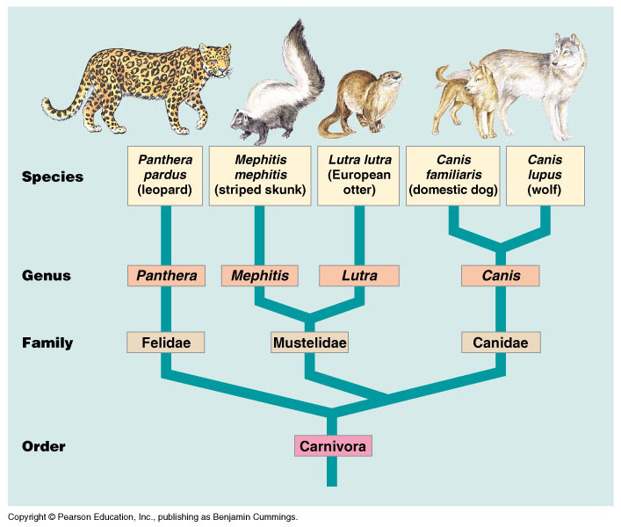

Slide 18
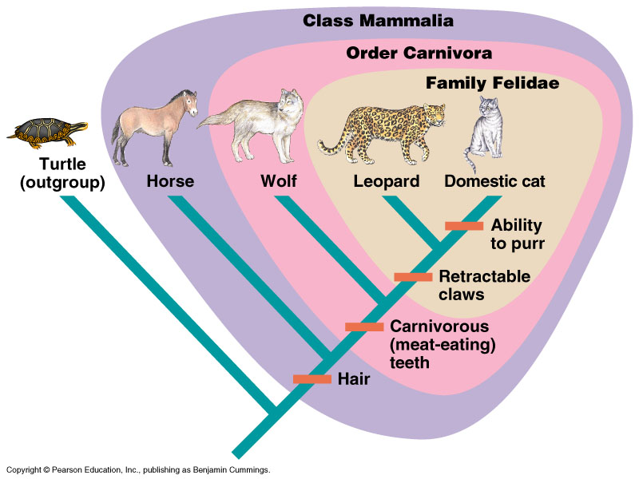
CLADOGRAMS

Slide 19
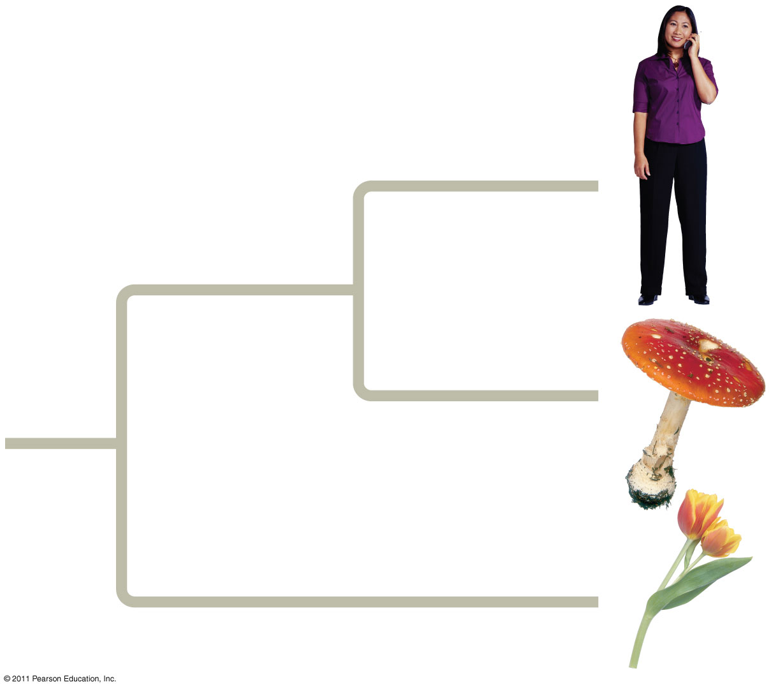
Figure 26.2
Notes:
Figure 26.2 An unexpected family tree.

Slide 20
Molecular Clocks
A molecular clock uses constant rates of evolution in some genes to estimate the absolute time of evolutionary change
© 2011 Pearson Education, Inc.

Slide 21
Molecular clocks are calibrated against branches whose dates are known from the fossil record
Individual genes vary in how clocklike they are
© 2011 Pearson Education, Inc.

Slide 22
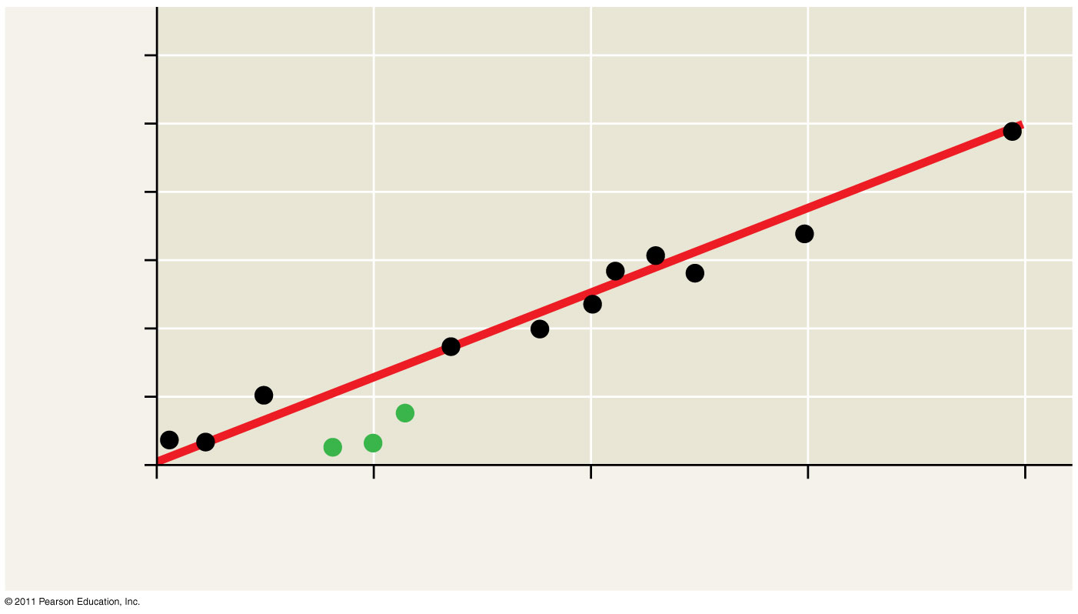
Figure 26.19
90
60
Number of mutations
30
0
30
60
90
120
Divergence time (millions of years)
Notes:
Figure 26.19 A molecular clock for mammals.

Slide 23
Problems with Molecular Clocks
The molecular clock does not run as smoothly as neutral theory predicts
Irregularities result from natural selection in which some DNA changes are favored over others
Estimates of evolutionary divergences older than the fossil record have a high degree of uncertainty
The use of multiple genes may improve estimates
© 2011 Pearson Education, Inc.

Slide 24
Applying a Molecular Clock: The Origin of HIV
Phylogenetic analysis shows that HIV is descended from viruses that infect chimpanzees and other primates
HIV spread to humans more than once
Comparison of HIV samples shows that the virus evolved in a very clocklike way
Application of a molecular clock to one strain of HIV suggests that that strain spread to humans during the 1930s
© 2011 Pearson Education, Inc.

Slide 25
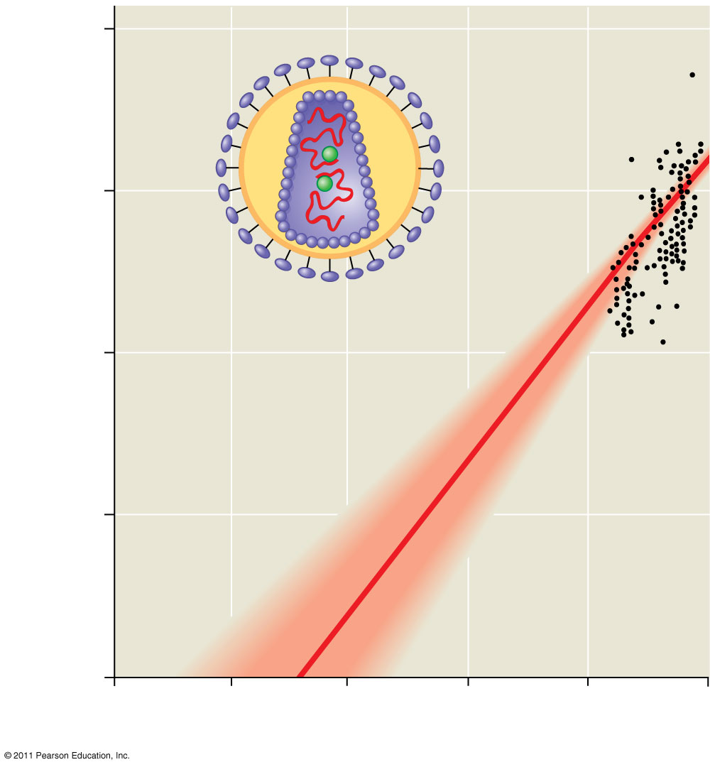
Figure 26.20
0.20
0.15
HIV
Index of base changes between HIV gene sequences
0.10
Range
Adjusted best-fit line
(accounts for uncertain
dates of HIV sequences)
0.05
0
1900
1920
1940
1960
1980
2000
Year
Notes:
Figure 26.20 Dating the origin of HIV-1 M with a molecular clock.

